Slide 1
LESSON 6.3b
Inverses of Logarithms

Slide 2
Today you will:
Use inverse properties of logarithmic and exponential functions
Graph logarithmic functions
Practice using English to describe math processes and equations

Slide 3
Core Vocabulary:
Logarithm base $b$ of $y$, p. 310
Previous:
Inverse functions

Slide 4
First, a few items of important review we will need for today…

Slide 5
Where is the “base” in an Exponential Function?
$$y=ab^{x}$$
Base

Slide 6
Where is the base in a Logarithm?
Base
$$\log_{b}{y}=x$$

Slide 7
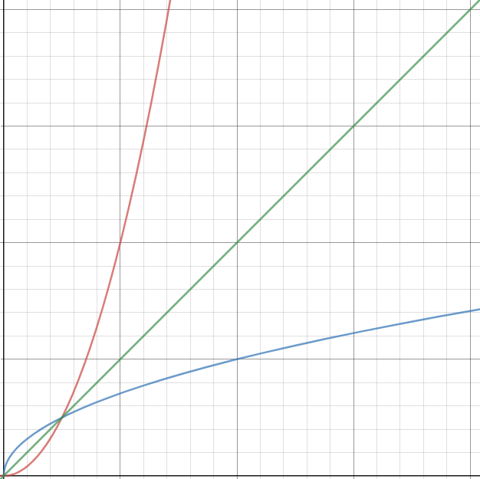
What does it mean that one function is the inverse of another?
They are “opposites”
They “undo” each other
Their graphs are reflections around the line $y=x$
If you plug one into the other and simplify, you end up with just $x$
Example:
$f\left(x\right)=4x^{2}$ and $g\left(x\right)=\frac{1}{2}\sqrt{x}$
$$f\left(g\left(x\right)\right)=4{\left(\frac{1}{2}\sqrt{x}\right)}^{2}=4\left(\frac{1}{4}x\right)=x$$
$$g\left(f\left(x\right)\right)=\frac{1}{2}\sqrt{4x^{2}}=\frac{1}{2}\left(2x\right)=x$$
$$f(x)$$
$$y=x$$
$$g(x)$$

Slide 8
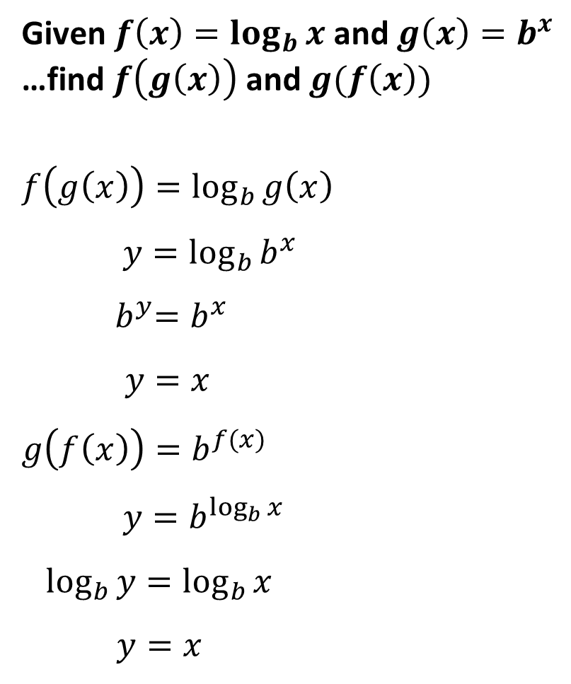
Given $f\left(x\right)=\log_{b}{x}$ and $g\left(x\right)=b^{x}$
…find $f\left(g\left(x\right)\right)$ and $g(f\left(x\right))$
$$f\left(g\left(x\right)\right)=\log_{b}{g\left(x\right)}$$
$$y=\log_{b}{b^{x}}$$
$${ b}^{y}=b^{x}$$
$y=x$
$$g\left(f\left(x\right)\right)=b^{f(x)}$$
$$y=b^{\log_{b}{x}}$$
$\log_{b}{y}=\log_{b}{x}$
$y=x$
This shows that $y=\log_{b}{x}$ and $y=b^{x}$ are inverses of each other!
Write $f(x)$ plugging in $g\left(x\right)$
Rewrite as $y=$ and fill in what $g\left(x\right)$is
Rewrite in exponential form: $x=\log_{b}{y}\text{→} y=b^{x}$
The statement can only be true if $y=x$
Write $g(x)$ plugging in $f\left(x\right)$
Rewrite as $y=$ and fill in what $f(x)$ is
Rewrite in logarithmic form: $y=b^{x}$ → $x=\log_{b}{y}$
The statement can only be true if $y=x$

Slide 9

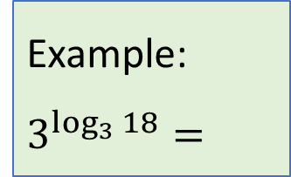
What does this mean?
If you see something in exponent form like this:
Log in the exponent
$$b^{\log_{b}{x}}$$
Example:
$$3^{\log_{3}{18}}=$$
$$18$$
Both having the same base…
The answer is $x$
Why?
Because this is $g\left(f\left(x\right)\right)$ from the prior slide.

Slide 10
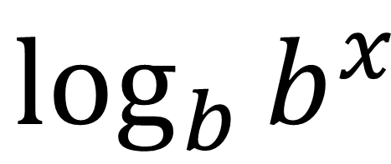
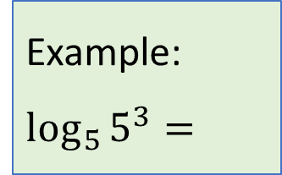
Or if you see something in logarithmic form like this:
Log of an exponential
$$\log_{b}{b^{x}}$$
Example:
$$\log_{5}{5^{3}}=$$
Both having the same base…
$$3$$
The answer is $x$
Why?
Because this is $f\left(g\left(x\right)\right)$ from the prior slide.

Slide 11
Simplify (a) 10^{log 4} and (b) log₅ 25^{x}.
SOLUTION
a. 10^{log 4} $=$ 4
b^{logbx} $=$ x
b. log₅ 25^{x} $=$ log₅(5²)^{x}
Express 25 as a power with base 5.
$=$ log₅ 5^{2x}
Power of a Power Property
$=$ 2x
log_{b} b^{x} $=$ x

Slide 12
How do you find the inverse of a logarithmic or exponential function?
Follow the normal process:
Rewrite as $y=$
Swap $x$ and $y$
Solve for $y$
If in exponent form, convert to logarithmic form
If in log form, convert to exponential form

Slide 13
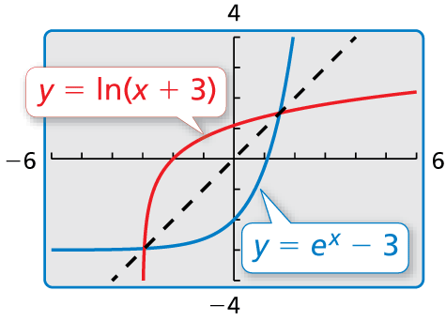
Find the inverse of each function.
a. f(x) $=$ 6^{x}
b. y $=$ ln(x $+$ 3)
SOLUTION
a. From the definition of logarithm, the inverse of f(x) $=$ 6^{x} is g(x) $=$ log₆ x.
b. y $=$ ln(x $+$ 3)
Write original function.
x $=$ ln(y $+$ 3)
Switch x and y.
e^{x} $=$ y $+$ 3
Write in exponential form.
e^{x} $−$ 3 $=$ y
Subtract 3 from each side.
The inverse of y $=$ ln(x $+$ 3) is y $=$ e^{x} $−$ 3.
Check
✓
a. f(g(x)) $=$ 6^{log6 x} $=$ x
b.
✓
g(f(x)) $=$ log₆ 6^{x} $=$ x
The graphs appear to be reflections
of each other in the line y $=$ x.
✓

Slide 14
Homework
Pg 315, #35-54

